Slide 1
Monstah Operating System
(MOS)
Marist College
Poughkeepsie NY
Second Iteration
November 5, 2007
Group 4
Dan Mangiarelli
Craig Fargione
and
Dave Weisfelner

Slide 2
Outline
User Created Input File(s)
a. Overview
b. Specifications
c. Program Control Commands
d. Program Data
Operating System
a. Memory
b. CPU
c. Operation Commands
III. Program Output for User Input File(s)
a. Overview

Slide 3
User Created Input File(s)
An input file is a text (.txt) file that a given user has created to run on the MOS machine.
This input file may be composed of one or more programs that are to be run on the MOS.
Individual programs must be made up of certain things:
  - Program Control Commands
  Program Cards
  Data
  Program end line

Slide 4
User Created Input File(s) con’t.
The program header
Example of a program header:
$JOB0401ttttllll
What is each part of the header?
$JOB 04 01 tttt llll
The line limit says that there can only be a certain number of lines of output for a given program.
The time limit limits the number of operations that the MOS can do. This will prevent things like an infinite loop from happening.
Group program number.
Output line limit for the program.
Shows the beginning of a user program.
Group number.
Time limit on the program.

Slide 5
User Created Input File(s) con’t.
  Program control commands:
      $JOB - Delineates the beginning of a program.
      $DTA - Delineates the instructions from the data.
      Execution of instructions begins when the
      MOS sees this command.
      $EOJ - Delineates the end of each program.
      This tells the MOS that there is no more
      data to be read from the program.

Slide 6
  User Created Input File(s) con’t.
  Program Cards:
    GD40LR41SR50SR51LR40SR60SR61SR62LR42SR70
    LR44SR71LR45………H
    The “H,” for Halt, tells the MOS that there are no more instructions and to move on in the program.
    Each line of may only have 10 instructions because that is the maximum size.

Slide 7
User Created Input File(s) con’t.
- Data Card:
$DTA
THIS LINE IS DATA FOR USER PROGRAM.
- End line for each program:
$END0401
Program Specifics
Each program must have the given program control commands or it will not be recognized as a command by the MOS.
If you have more than one user program on a given input file, there should not be any spaces between the programs.
Signals the end of a user program.
Group program number.
Group number.

Slide 8
MOS Memory
- The memory in our MOS is a two dimensional array of size 300 x 4.
- Each block of 4 bytes is called a word.
When a command is read from the input file, it is first placed in a String buffer and then placed into the correct memory location from the buffer.
- The buffer length is 40 bytes.
00 01 02 03
00
10
20
30
40
50
.
.
.
.
.
.
.
299

Slide 9
Paging
Paging allows for non contiguous memory allocation.
Divide physical memory into equal size blocks called frames.
Virtual memory is then broken up into equal sized blocks called pages.
When a program comes in that requires n free frames of memory, the OS goes through and finds those n frames (do not need to be contiguous in main memory).

Slide 10
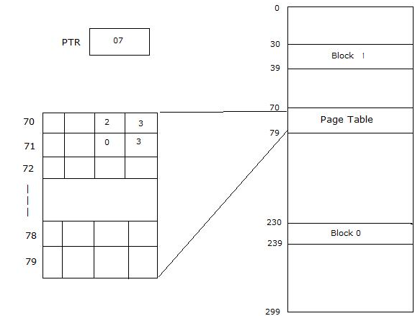
Page Table
The page table is stored in main memory.
The Page Table Register (PTR) keeps track of the starting address in memory where the page table is located.

Slide 11
Page Faults
There are two types of page faults associated with MOS.
One is a valid page fault.
A valid page fault is when you are trying to store data and there is memory available to be allocated for the data. The memory location is then allocated and program execution continues.
The second is an invalid page fault.
An invalid page fault occurs when the OS is trying to read data from memory that has not been allocated. This causes and error and the program execution is terminated.
Each of these page faults are associated with the Page Interrupt having a specific value, this is explained later on in the presentation.

Slide 12

The Operating System
The CPU contains 5 registers:
IR – Instruction Register
This register is not accessible to the user. Every instruction that is executed comes from the IR. It is 4 bytes long, the reason being that Program Cards are 4 characters long.
CPU
PTR
R
C
IR
G
D
4
0
IC

Slide 13
The Operating System con’t.
IC – Instruction Counter
The CPU uses this register to keep track of which instruction will be executed next. The IC is 2 bytes long. Whatever number is in the IC is the next instruction that will be executed.
CPU
PTR
R
C
IR
IC
0
4

Slide 14
The Operating System con’t.
R – General Purpose Register
This register has a size of 4 bytes and, unlike the IR, is available to the user in their program. The user can place any 4 characters that they wish in this register for temporary storage for operations such as reading, writing, storing and comparing data.
CPU
PTR
R
N
A
V
Y
C
IR
IC

Slide 15
The Operating System con’t.
C – The Compare Register
This register is only one byte long, and it contains a Boolean value. A call to the compare register such as CR50 will compare the contents of memory location 50 to the contents of the general purpose register. It will then set the contents of register C to “T” for true if the values are the same, otherwise it is set to “F” for false.
CPU
PTR
T
R
C
IR
IC

Slide 16
The Operating System con’t.
PTR – Page Table Register
This register is a two byte register that is not available to the user in the program. The page table register holds the frame number that the page table is located in main memory.
CPU
PTR
0
7
R
C
IR
IC

Slide 17
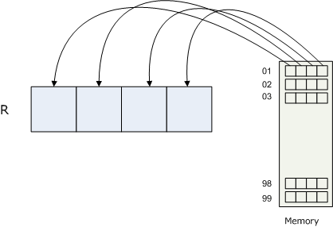
Operation Commands
(Slave Mode)
- Load Register (LR)
This loads the contents of the specified memory location into Register R.

Slide 18
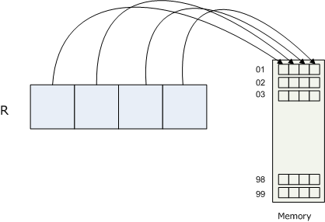
Operation Commands
(Slave Mode)
- Store Register (SR)
This stores the contents of Register R into the specified memory location.

Slide 19


Operation Commands
(Slave Mode)
- Compare Register (CR)
This sets the flag C to ‘True’ if the value of the contents of a given memory location is the same as the value of the contents of Register R. If the values are not the same, then the flag C is set to ‘False’

Slide 20

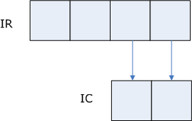
Operation Commands
(Slave Mode)
Branch on True (BT)
This operation checks to see if the flag C is set to true or false. If the flag is true, then the branch will take place, otherwise, the branch is not taken.

Slide 21

Operation Commands
(Slave Mode)
- Get Data(GD)
- Sets Supervisor Interrupt = 1
Print Data(PD)
- Sets Supervisor Interrupt = 2
Halt(H)
- Sets Supervisor Interrupt = 3

Slide 22
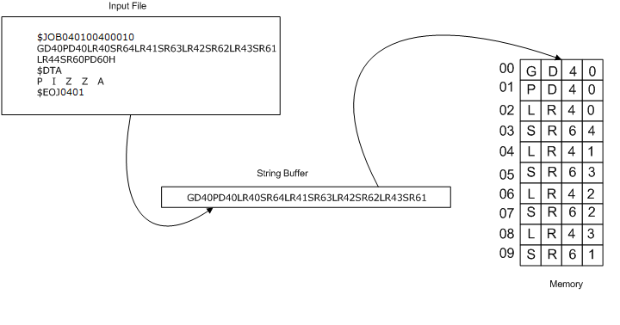
Master Mode
SI = 1
This gets the next data card from the input file, places it into a String buffer,
and then from the buffer, places it into the specified memory location.

Slide 23
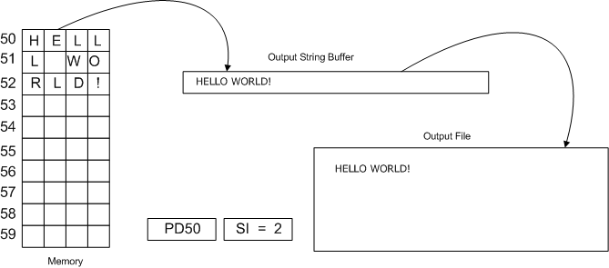
Operational Commands con’t
SI = 2
This takes the data from the given memory location, places it into a String buffer and from the buffer, prints the data.

Slide 24

Operational Commands con’t
SI = 3
MOS prints two blank lines.
This halts the current program
and starts execution of the next
program.
At this time, two lines are printed with: either Normal or Abnormal Termination, depending on if there are any errors. The first line also includes the total time limit and total line limit. The second line has the value of IR, IC, R, C and the actual time taken, the actual number of lines printed.

Slide 25
Time Interrupt
Values of TI
TI = 1
This means that the Time Slice has expired. When this occurs, the data from the current program is placed on the back of the Ready Queue and whatever program data is on the front of the Ready Queue is then brought into memory and the execution of that program is now started.
The Time Slice counter is part of what allows the MOS to do multiprogramming by taking a set time, 10 time units, executing the current program for the time limit, and then starting the next program. This process of running for ten time units and then taking the next program off the Ready Queue continues until each program has completed.

Slide 26
Time Interrupt
Values of TI
TI = 2
This means that the total time for the program to execute allocated by the user has expired. When this happens the program is terminated with a message saying that the total time has expired.

Slide 27
Page Interrupt
Values of PI
PI = 1
This means that there was an Operation error. The user probably typed a letter incorrectly and instead of having a GD they might have written something like FD. Since there is no operation code called FD, the program will terminate and give an error message saying that there was an invalid operation code.

Slide 28
Page Interrupt
Values of PI
PI = 2
This means that there was an Operand Error in the user’s program. Most likely, the user mistyped a letter when they were entering an operand in their user program. An example of this would be someone typing GD5o instead of GD50. Since the letter “o” will not ne recognized as a letter by MOS, it will terminate the users program and give an error message indicating that there was an invalid operand.

Slide 29
Page Interrupt
Values of PI
PI = 3
This means that there was a page fault. If this is the case, there can be two different things that happen.
Valid Page Fault –
A valid page fault is when you are trying to store data and there is memory available to be allocated for the data. The memory location is then allocated and program execution continues
Invalid Page Fault –
- An invalid page fault occurs when the OS is trying to read data from memory that has not been allocated. This causes and error and the program execution is terminated.

